Slide 1
PnP Community Call – June 2015
aka.ms/OfficeDevPnP
aka.ms/OfficeDevPnPYammer
aka.ms/OfficeDevPnPGuidance
aka.ms/OfficeDevPnPVideos
PnP Core Team

Slide 2

Agenda
Demos, demos, demos
Monthly highlights
Contributions and other topics
Roadmap and next steps

Slide 3

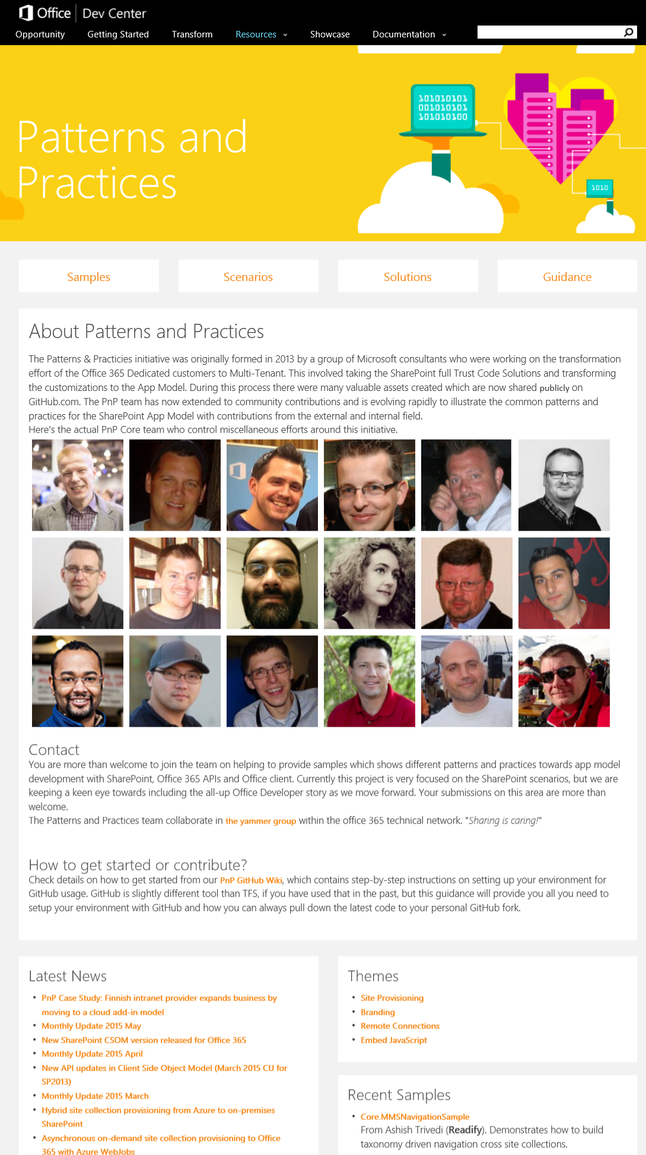
Developer
Patterns & Practices
aka.ms/OfficeDevPnP
aka.ms/OfficeDevPnPYammer
aka.ms/OfficeDevPnPMSDN
aka.ms/OfficeDevPnPVideos
aka.ms/OfficeDevPnPTraining

Slide 4
Statistics– Key numbers (previous month)
Forked 640 times (528, 444, 360, 282, 227, 190, 135)
679 merged/closed pull requests (593, 479, 384, 329, 280, 236, 189)
145 closed issues (131, 122, 101, 73, 67, 58, 43)
More than 4532 (4100, 4100, 3776, 2566, 3050, 2160) unique visitors during last 2 weeks
Nuget package 6698 downloads (6004, 5440, 4711, 4450, 4030, 3800)
Yammer group has 2648 members (2437, 2251, 2013, 1739, 1525, 1419, 757)
aka.ms/OfficeDevPnPYammer
Facebook page has 199 likes (194, 175, 135, 121)
https://www.facebook.com/OfficeDevPnP

Slide 5
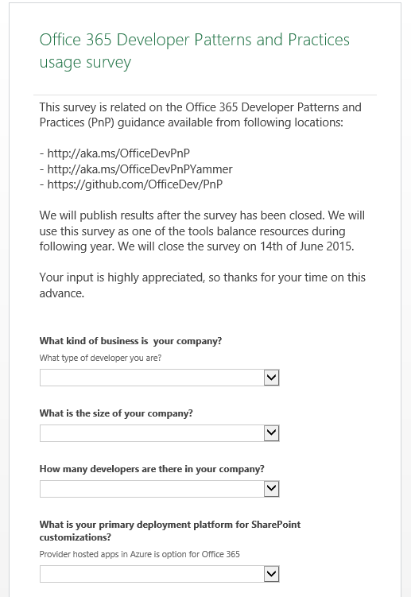
PnP Usage Survey
Open until 12th of June – for collecting feedback and input for the following stages of PnP
Introduction to survey – http://aka.ms/OfficeDevPnPSurvey
Direct survey link - http://aka.ms/OfficeDevPnPSurveyIntro

Slide 6
PnP GitHub Repository Split plan Latest during August
PnP – We will need to keep the root repo name intact to avoid issues for community, but this will be in future mainly for enterprise development. Components, samples and solutions will be still here, except few which are re-located to specific repos.
PnP-Guidance – Guidance articles which are at least partly linked to MSDN
PnP-Provisioning-Schema – Remote provisioning schema repository
PnP-Store – PnP samples for store apps (lower permission requirements)
PnP-Sites-Core – New repo for the PnP SP Core component (that existing one)
Scenarios will be located here, since they show how Core works
PnP-PowerShell – New repo where the PnP PowerShell is relocated (Erwin’s own backyard)
PnP-Office – New repo for PnP Office client samples (Word, Excel, PowerPoint, Outlook)
PnP-Office-Core – Future repository for Core component targeted for Office apps. Core can start at PnP-Office, but can be split when needed.
PnP-Office365-API – New repo for Office 365 API PnP topics
PnP-Office365-API-Core – Future repository for PnP Office 365 API Core component. Initial Office 365 API core starts in same repo as samples, but will be split when needed.
PnP-Partner-Pack – Future repository for partner pack materials

Slide 7
PnP provisioning engine - Capabilities
http://aka.ms/OfficeDevPnPEngineIntroVideo
Extract provisioning templates from live sites
You can use browser as your designer and extract template using either code or PowerShell
Extra also branding elements from sites
Serialize templates to JSOM or XML format (optional)
Read templates from SharePoint list, file system or Azure Blob store
Isolated engine without dependencies on specific technologies
Create templates just by using code
Apply multiple templates to one site
Standardized site configuration cross all site types and more specific sub configurations for the template level
Usable from managed code or with own PowerShell cmdlets
Supports both cloud and on-prem
On-prem support slightly behind with cloud
Can be used to move site configurations also cross environments
Dev – Test – Production
On-prem to cloud

Slide 8
June Release - new samples
New solution Provisioning.UX.App which shows a more comprehensive solution build around the PnP provisioning engine
New sample Core.JSOM.BinaryUpload demonstrates how to upload binary files from SharePoint Hosted App to the host web
New sample Core.ManageUserCustomActions shows how to manage UserCustomActions Objects using a Form interface where is possible to include/edit/delete UserCustomActions
New sample AzureAD.GroupAuthorization shows how to use windows Azure Active directory and the groups to authorize actions in your asp.net MVC app or Office 365 Add-In

Slide 9
June Release – Core and engine updates
Core
Massive amount of provisioning engine updates (see above)
Support for controlling Ratings and Likes settings in list
Ability to retrieve all available variation labels from site
Add multiple custom actions at once to site
Support for indexed property bag values added
Check for illegal characters for file, folder and site creation
Updated unit tests to better support app-only and on-premises testing
Both PnP Core Nuget packages (cloud and on-premises) have been also updated accordingly.
PnP Provisioning Engine
Bug fixes related on the on-premises support
Support for enabling drafts in lists
Set welcome page for site
Better lookup field support
Better root template detection for all OOB site definitions
JSON formatter for template configuration
Testing and additional support for on-premises usage

Slide 10
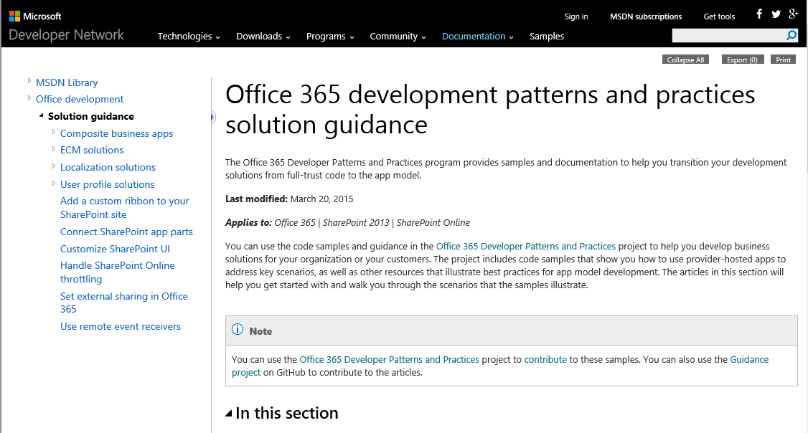
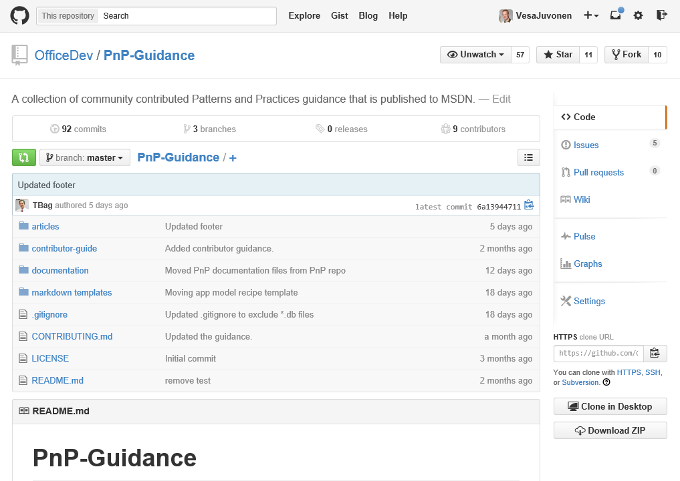
June release - guidance updates
Constant updates based on MSDN articles
Branding and site provisioning solutions for SharePoint 2013 and SharePoint Online
New recipes articles gradually being added
Authored based on the PnP team input by Todd Baginski
App model recipe - MMS manipulation
App model recipe - Elevated privileges
App model recipe - OneDrive for Business customization
App model recipe - User controls and Web controls
New videos
Introduction to PnP PowerShell Cmdlets
Getting Started with PnP Provisioning Engine
Deep dive to PnP provisioning engine schema
Guidance – http://aka.ms/OfficeDevPnPGuidance
MSDN– http://aka.ms/OfficeDevPnPMSDN
Videos – http://aka.ms/OfficeDevPnPVideos

Slide 11

Thank you for your assistance! – 1/2
Akhilesh Nirapure (Rapid Circle) - @AkhileshN
André Lage (Processlynx AG) @aaclage
Arnold Boersma (Deloitte) - @arnoldboersma
Chirag Bhatia - @chirag64
Erwin van Hunen (Knowit AB) - @erwinvanhunen
Ivan Vagunin (Knowit AB) - @ivagunin
Joshua Petryk (Black Lance Technologies LLC)
Luis Valencia - @levalencia
Marco Wiedemeyer (Otto Group) - @mwiede
Paolo Pialorsi (PiaSys.com) - @PaoloPia

Slide 12
Thank you for your assistance! – 2/2
Patrik Björklund (Alloc IT) - @pbjorklund
Radi Atanassov (OneBit Software) - @RadiAtanassov
Robrecht Van Caenegem (U2U)
Scot Hillier - @ScotHillier
Stefan Bauer (n8d) - @StfBauer
Tobias Zimmergren (Tozit AB) - @zimmergren
Torsten Schuster
Vladimir (OneBit Software)
ZeBobo5 - GitHub alias
MS people – Antons Mislevics, Bert Jansen, Brian Michely, Dan Budimir, Doug Perkes, Frank Chen, Frank Marasco, Jeremy Thake, Jonathan Huss, Kiki Shuxteau, Laura Graham, Reeza Ali, Ricky Kirkham, Ron Tielke, Sami Nieminen, Steve Walker, Vesa Juvone

Slide 13

Roadmap – August release plan
Provisioning engine
Delta handling
Documentation
On-premises testing
Core component v1.x
Continue evolving the Core component
Samples and solutions
Contributions from the field
Transformation IP
Articles and guidance
MSDN updates
On-premises App model setup – options and details on the needed configuration
ALM
Recipes for transformation
JDP transformation process to be released as reusable package for the field

Slide 14
Feedback…
Please keep the feedback coming in Yammer… we need your input for the prioritization.
Survey available until 12th of June at http://aka.ms/OfficeDevPnPSurvey
Notes:
Priority on planned topics
More code samples
Add core component capabilities
Reusable presentation material
Documentation on patterns and practices for app model (ALM ec.)
More complex solutions
More Office Client apps
More JavaScript app
Length: 30 second for this slide
Instructor notes
The following slides will walk you though the Lync tools that we will use in this class.
You will use all of these tools later in the class
Stress that your students will be able to run much more engaging meetings if they use these tools in their own Lync Meetings.
Course Development Notes:

Slide 15

Demos, demos, demos!
Frank Marasco – Provisioning UI
Solution which uses PnP engine
Demo and introduction on the approach
Stefan Bauer – JSOM Binary Upload
Sample introduction

Slide 16
Transform your code Providing add-in model patterns for SharePoint, Office and Office 365 APIs. Ready to use samples to get started.
130+ Visual Studio projects Common scenarios
Branding
Site provisioning
Remote event receivers
Large file support
Taxonomy driven navigation
And much more…
Contribute
This is open source project and open for contributions
Developer
Patterns & Practices
aka.ms/OfficeDevPnP

Slide 17

Questions?

Slide 18


© 2015 Microsoft Corporation. All rights reserved. Microsoft, Windows, and other product names are or may be registered trademarks and/or trademarks in the U.S. and/or other countries.
The information herein is for informational purposes only and represents the current view of Microsoft Corporation as of the date of this presentation. Because Microsoft must respond to changing market conditions, it should not be interpreted to be a commitment on the part of Microsoft, and Microsoft cannot guarantee the accuracy of any information provided after the date of this presentation. MICROSOFT MAKES NO WARRANTIES, EXPRESS, IMPLIED OR STATUTORY, AS TO THE INFORMATION IN THIS PRESENTATION.

